Slide 1
Facebook API and Regular Expression
Maggie Chang
2016.06.18

Slide 2
Agenda
Facebook Graph API Introduction
Facebook Graph API Crawling
Regular Expression

Slide 3
Agenda
Facebook Graph API Introduction (30 mins)
UI 介面
Syntax
Components
Metadata=1
Modifier

Slide 4
Agenda
Facebook Graph API Crawling (90 mins)
HTTP request
Exercise1: 抓取metadata fields
Exercise2: 抓取所有分頁結果
Exercise3: 我的按讚趨勢
Exercise4: Facebook機器人
Exercise5: 幫朋友按讚，成為狂讚士
Exercise6: 抓取所以文章comments紀錄

Slide 5
Agenda
Regular Expression (60 mins)
What is Regex?
Why we need it?
Replace/ Filter功能
Basic Component
Exercise8: 抓取日期資料格式
Exercise9: 抓取PTT版特殊pattern

Slide 6
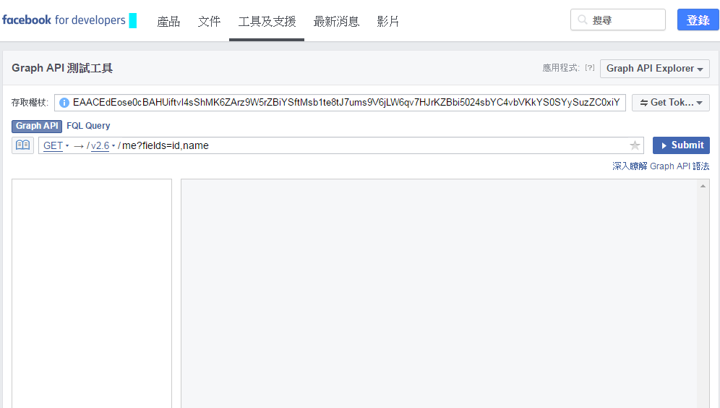
Facebook Graph API Explorer
need a valid access token
the token will expire in hour (and can be refreshed)
Notes:
https://developers.facebook.com/tools/explorer

Slide 7
Baisc Syntax
/<node_id>/<edge_name>?fields=f1,f2,...
釋例：me/photos?fields=from
nodes
objects: a User, a Photo, a Page, a Comment, …
edegs
connections between objects
fields
information about objects

Slide 8









Components of the API
family
photos
movies
id
name
about
age_range
gender
location
context
videos
ME
albums
friends
tagged_places
feed

Slide 9




Node? Edge?
likes
id
album
Created_time
from
name
link
tags
Photo
comments

Slide 10
Node? Edge?
edge is the population, node is the individual
“all of my photos” => edge (no id)
“this photo of mine” => node (with id)
difference in syntax (and returned json):
field querying: me?fields=photos.fields(from)
edge querying: me/photos?fields=from

Slide 11
Nested Query
允許巢狀結構
<node_id>?fields=f1.fields(subf1,subf2,...),f2,...
釋例： me?fields=photos.fields(from,id)

Slide 12
Find all Fields/Edges
<node_id>?metadata=1
釋例： me?metadata=1
常用：
photos, posts, feed, likes, reactions, tagged_place, comments

Slide 13
Limit Modifiers
limit: 限制單頁顯示資料個數
on field:
me?fields=photos.limit(10)
on edge:
me/photos?limit=10
Notes:
修飾子

Slide 14
Summary Modifiers
summary: 總計
on field:
<photo_id>?fields=likes.summary(true)
on edge:
<photo_id>/likes?summary=true

Slide 15
Since Modifiers
since: 設定起始日期，需使用unix時間格式
on field:
won’t work
on edge:
me/posts?since=1420070400
what is unix time? (unix time converter)
total seconds elapsed since 1970-01-01 UTC time
1420070400 is 2015-01-01 UTC

Slide 16
Query Modifiers
允許複數Modifiers
on field:
<photo_id>?files=likes.limit(1).summary(true)
on edge:
<photo_id>/likes?limit=1&summary=true

Slide 17
Try it : 找出是誰在按我的文章讚

Slide 18
思考步驟
start from me
is posts an edge or a field of me?
either of the following query works:
me/posts
me?fields=posts
pickup an arbitrary post
how many fields does it have?
use metadata=1 query string to investigate!
is likes an edge or a field of posts?
use the since modifier to specify a starting time
use the summary modifier to get a total counts

Slide 19
參考解答
參考解答： me/posts?fields=likes.summary(true)&since=1420070400&limit=100

Slide 20
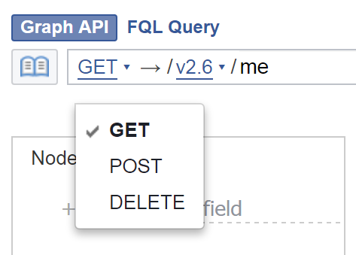
GET, POST, and DELETE
GET: 查詢
POST: OP文, 按讚
DELETE: 刪文, 取消讚

Slide 21
Agenda
Facebook Graph API Crawling (90 mins)
HTTP request
Exercise1: 抓取metadata fields
Exercise2: 抓取所有分頁結果
Exercise3: 我的按讚趨勢
Exercise4: Facebook機器人
Exercise5: 幫朋友按讚，成為狂讚士
Exercise6: 抓取所以文章comments紀錄

Slide 22

HTTP request
Get method
Facebook Graph API 右下角：取得代碼(Get Code)
選擇cURL 格式
curl -i -X GET \
"https://graph.facebook.com/v2.6/me?fields=id%2Cname&access_token=EAACEdEose0cBAIVrZBQPdVwfFBoV1n1wHiJYhVS5MJCOUsASmO2iRtZCJSdP8xU79JokvsBVOMWKpxbedrfVR5ybEpRl5EZB3uhEgnVOXXPT8KgXk2gKpkZBVWe4ZAr1AJ32GajuFbyZAmJWBkHkkdNmQRgMXn01CnrJoCpH5kTQZDZD"

Slide 23
Exercise1: 抓取”me”所有metadata fields

Slide 24
Exercise1: 思考步驟
start from me
me?metadata=1
觀察http request
Get method
Data parser

Slide 25
Exercise1: 參考解答
R code參考解答

Slide 26
Exercise2: 抓取所有分頁結果

Slide 27
Exercise2: 思考步驟
以一篇文章按讚者清單為例
me/feed ( get post id )
<post_id>/reactions or <post_id>?fields=likes
觀察 資料位置 與 URL
如果觀察不到分頁情況，可使用limit()設定
<post_id>/reactions?limit=2 or <post_id>?fields=reactions.limit(2)
Get method
Data parser

Slide 28
Exercise2: 參考解答
R code參考解答

Slide 29
Exercise3: 我的按讚趨勢

Slide 30
Exercise3: 思考步驟
特定時間內，所有文章按讚趨勢圖
需要設定時間、抓取所有文章 ID、文章按讚者資料
me/feed?fields=created_time,reactions&since=1420070400
觀察！！！
Get method
Data parser
Hint: 建議將程式分成不同功能function撰寫

Slide 31
Exercise3: 參考解答
R code參考解答

Slide 32
Exercise4: Facebook機器人

Slide 33
Exercise4: 思考步驟
自動PO文、按讚、刪文
me
觀察！！！
POST method

Slide 34
Exercise4: 參考解答
R code參考解答

Slide 35
Exercise5: 成為狂讚士

Slide 36
Exercise5: 思考步驟
挑選一位朋友，對其所有文章按讚
觀察！！！
POST method

Slide 37
Exercise5: 參考解答
R code參考解答

Slide 38
Exercise6: 抓取文章Comments紀錄

Slide 39
Exercise6: 思考步驟
挑選單篇文章，抓取所有Comments紀錄
觀察！！！
注意：comments中的reply
GET method
Data parser

Slide 40
Exercise6: 參考解答
R code參考解答

Slide 41
Agenda
Regular Expression (60 mins)
What is Regex?
Why we need it?
Replace/ Filter功能
Basic Component
Exercise: 抓取日期資料格式
Exercise: 抓取PTT版特殊pattern

Slide 42
What is Regex?
…a sequence of characters that define a search pattern, mainly for use in pattern matching with strings, or string matching, i.e. “find and replace”-like operations.
-wikipedia

Slide 43
Why we need Regex?
當資料結構混亂不一致，只用CSS selector/Xpath selector無法有效取得資料。
處理大量字串時使用，例如log資料
需要抓取大量特定pattern時，例如日期、電話號碼、email、IP等

Slide 44
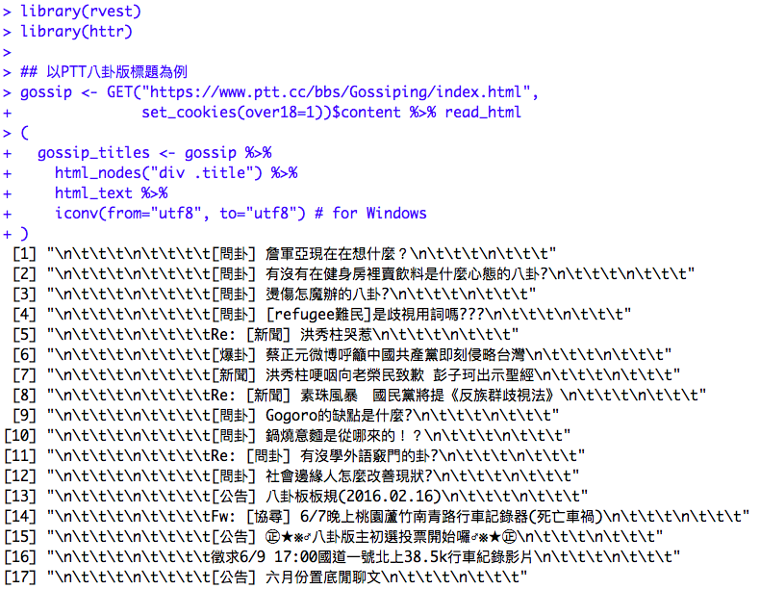
以PTT八卦版標題為例
R Code連結

Slide 45
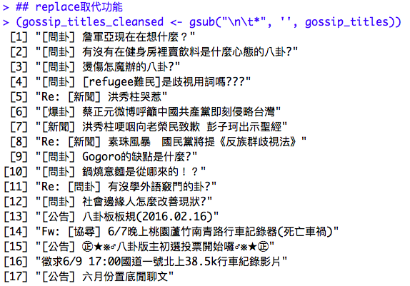
Replace 取代功能
取代將標題中的”\n與\t”

Slide 46
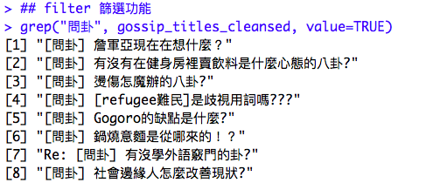
Filter 篩選功能
抓取含”問卦”的標題

Slide 47

Filter 篩選功能
抓取”Re開頭”的標題

Slide 48
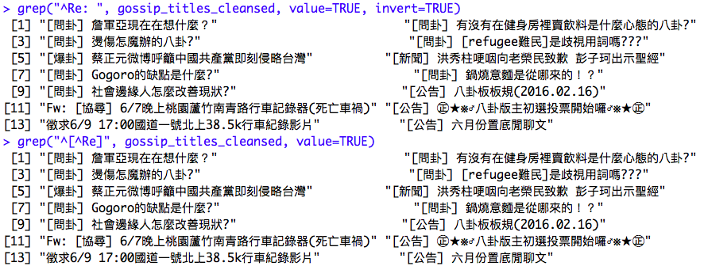
Filter 篩選功能
抓取”非Re開頭”的標題

Slide 49
Basic components
字面字元 (string-literals)
例如：ABCabc123
詮釋字元 (meta-characters)
例如：. ^ $ * + ? { } [ ] \ | ( )
特殊字元 (short-cuts)
例如：\d \D \s \S \w \W \b \B

Slide 50
Basic components
R Code連結

Slide 51
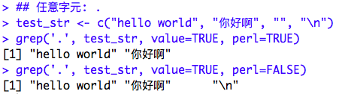
Meta-characters .
任意字元：符合任意字元，不包含空字元
範例

Slide 52
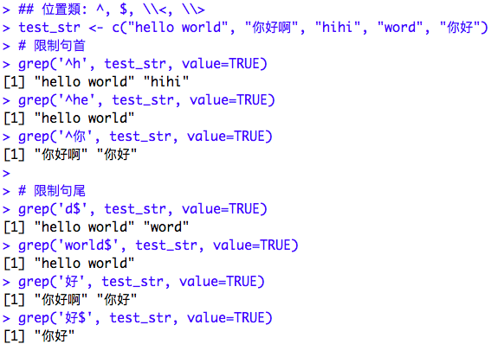
Meta-characters ^,$,\\<,\\>
位置類：出現為行首行尾、字首字尾

Slide 53
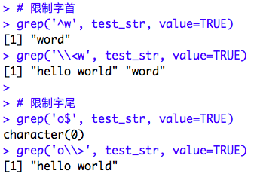
Meta-characters ^,$,\\<,\\>
位置類：出現為行首行尾、字首字尾

Slide 54
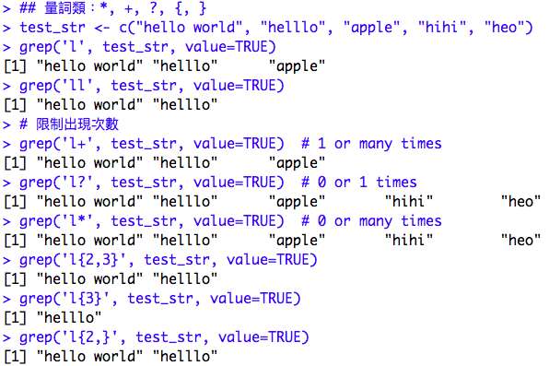
Meta-characters * + ? { }
量詞類：滿足出現特定次數
範例

Slide 55
Meta-characters * + ? { }
量詞類：滿足出現特定次數
量詞
? | 問號(question) | 允許 0 個或 1 個
* | 星號(star) | 允許 0 個或多個
+ | 加號(plus) | 允許 1 個或多個
{下限, 上限} | 指定範圍(specified range) | 至少要下限，最多允許上限

Slide 56
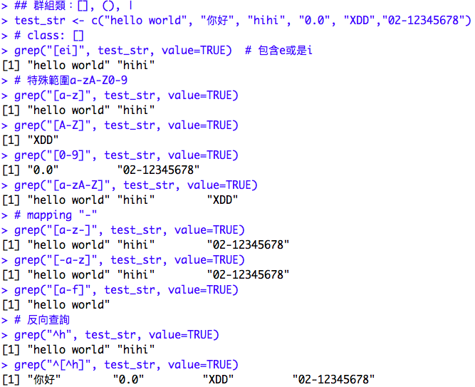
Meta-characters [], (), |
群組類：允許特定特定範圍、特定字母

Slide 57
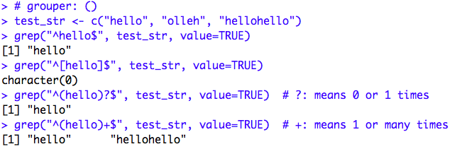
Meta-characters [], (), |
群組類：允許特定特定範圍、特定字母

Slide 58
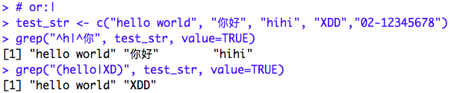
Meta-characters [], (), |
群組類：允許特定特定範圍、特定字母

Slide 59
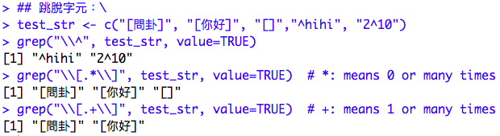
Meta-characters \\
跳脫字元：跳脫預設功能
範例

Slide 60
特殊字元
\\d: any decimal digit => [0-9]
\\D: any non-digit => [^0-9]
\\s: any white space => [ \t\n\r\f\v]
\\S: any non-white space => [^ \t\n\r\f\v]
\\w: any alphanumeric => [a-zA-Z0-9_]
\\W: any non-alphanumeric => [^a-zA-Z0-9_]
\\b: matches the empty string, but only at the beginning or end of a word (\\w)

Slide 61
RegEx in R
base::grep and base::grepl 基本篩選功能
base::gsub 基本取代功能
stringr package 進階篩選功能 (str_extract , str_extract_all ,str_match and str_match_all)
R code連結

Slide 62
Exercise: 抓取日期資料格式

Slide 63
Exercise: 參考解答
Data:
02/22/16 02-22-16 02.22.16
R Code連結

Slide 64
Exercise: 抓取PTT版特殊pattern

Slide 65
Exercise: 參考解答
R Code連結

